Slide 1
Wine Review Analysis
Anastasiaa Iozano, Jacob Kaplan , Jagan Munagala, Varsha Ramachandran, Vittal Siddaiah

Slide 2
The Data Set
Wine review data compiled by WineMag.com
Roughly 130,000 different wines from all over the world.
Questions:
How does the price/rating of the wine relate to the province/country it’s produced in?
How does the price/rating of the wine relate to the region it’s produced in.
Do different wineries produce higher quality or more expensive wine on average?
How does the price/rating relate to the vintage of the wine?
How does the price/rating of the wine relate to the variety of wine?

Slide 3
Correlation between Wine Ratings and Location
Considerations:
Number of data points after cleaning dataset: 129,909
‘nan’ values changed to ‘Unlisted’
Questions asked:
How does wine rating differ by country?
Which provinces produce most wine (top 30)?
What is the average rating for most wines?
There are provinces with higher number of vineyards/wineries? Does this translate to higher wine ratings for a country?
Does a higher wine rating imply most coveted wine?

Slide 4
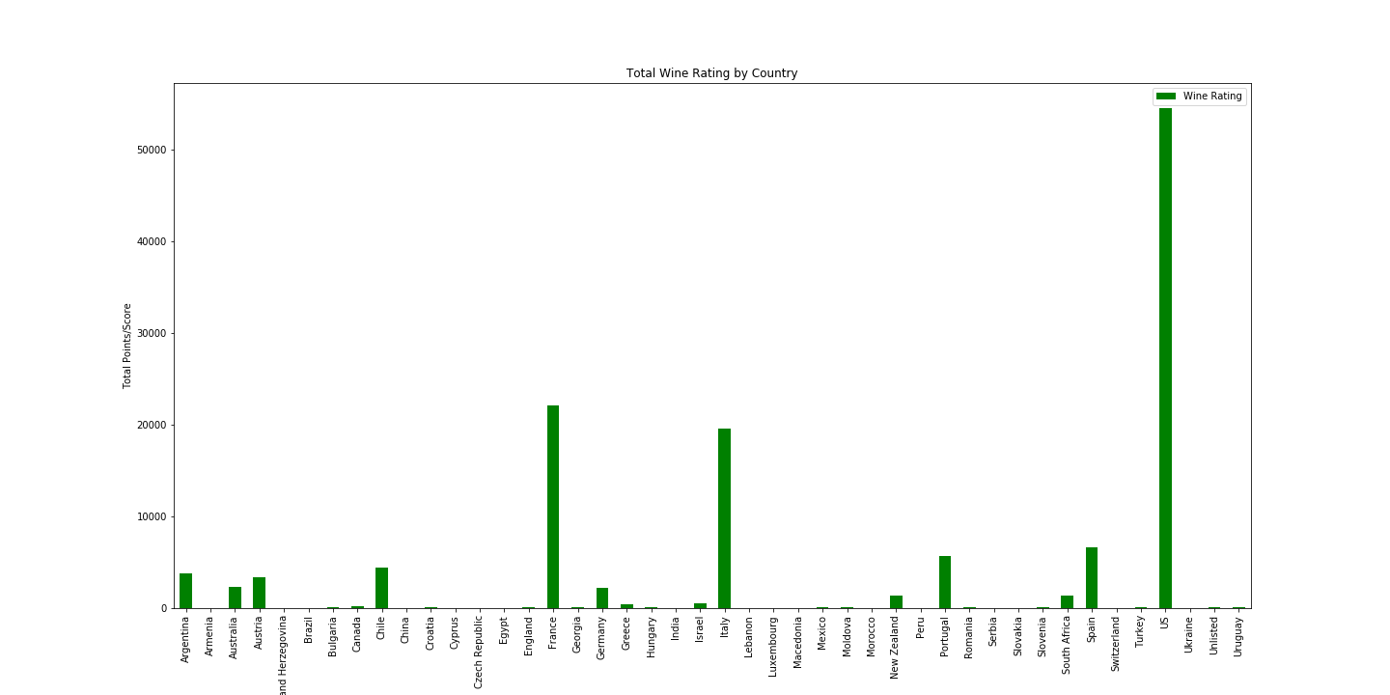
Total Wine Ratings by Country
Top 5 Ratings:
USA: 54,504 (42%)
France: 22,093 (17%)
Italy: 19,540 (15%)
Spain: 6,645 (5%)
Portugal: 5,691 (4.4%)

Slide 5
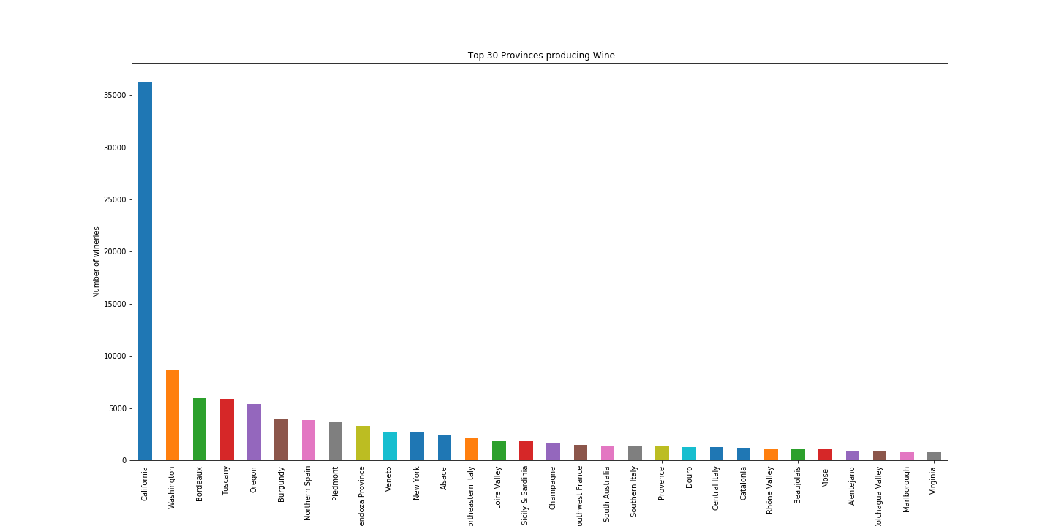
Top 30 Wine producing Provinces
Datapoints Count: 129,909
California: 36,248 (28%)
Washington: 8,640 (6.7%)
Bordeaux: 5,942 (4.6%)
Tuscany: 5,898 (4.5%)
Oregon: 5,374 (4.1%)
Burgundy: 3,981 (3.1%)
Northern Spain: 3,852 (3%)
Texas: 95 (0.07%)

Slide 6
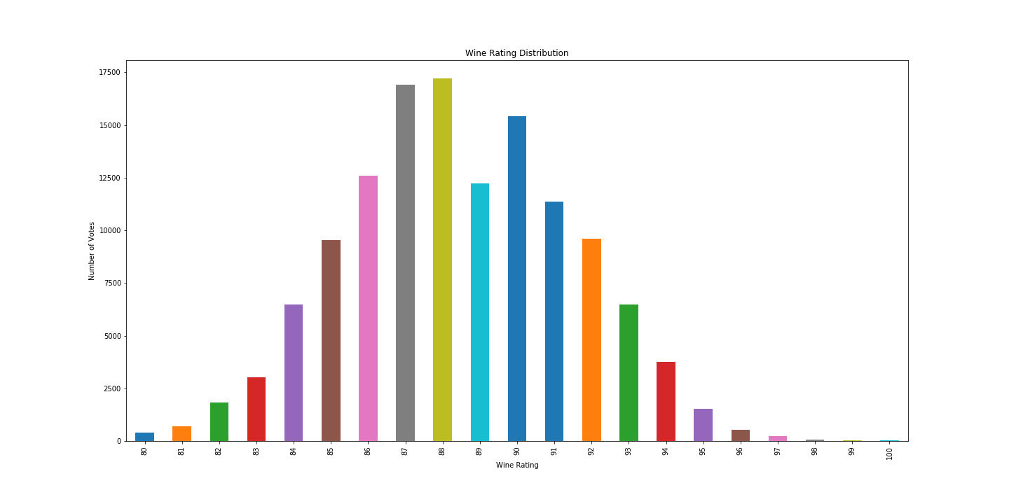
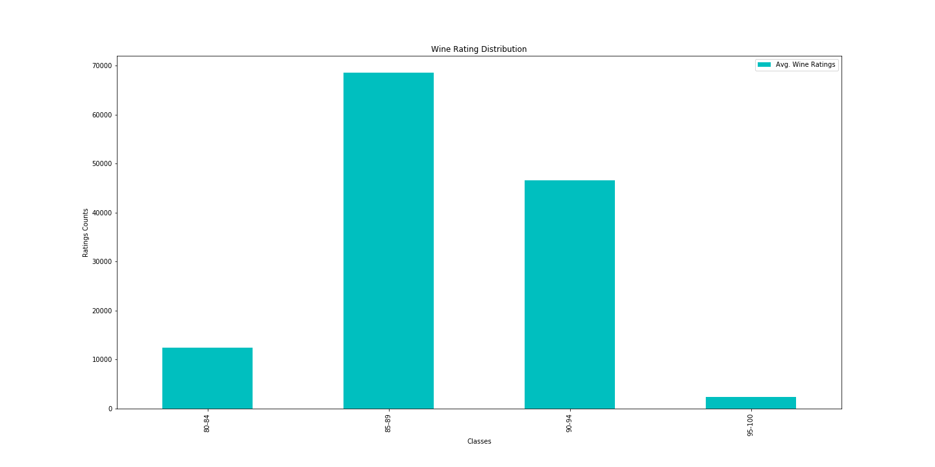
Wine Rating Distribution
Total Ratings Count:129,909
Avg. Wine Rating

Slide 7
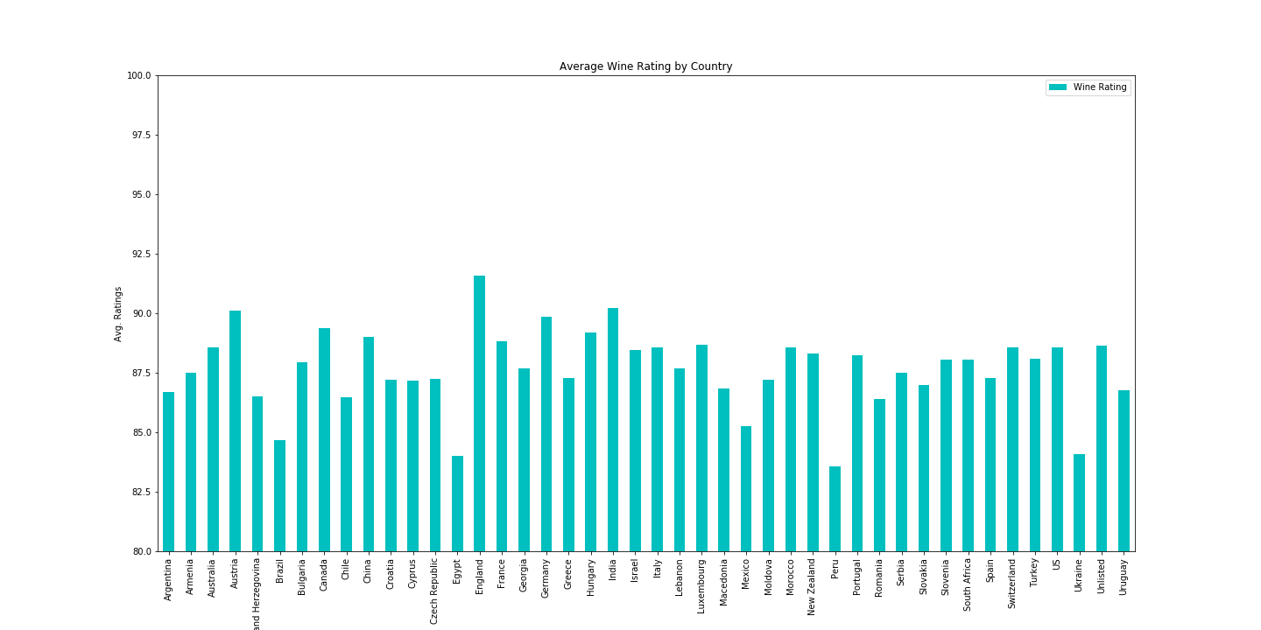
Average Wine Ratings by Country

Slide 8
Avg. Wine Ratings for top 12 Countries
S.No. | Country | Total Ratings | Avg. Rating
1 | England | 75 | 91.6
2 | Austria | 3,345 | 90.1
3 | Germany | 2,165 | 89.9
4 | Canada | 257 | 89.4
5 | France | 22,093 | 88.8
6 | USA | 54,504 | 88.6
7 | Italy | 19,540 | 88.6
8 | Australia | 2,329 | 88.6
9 | Portugal | 5,691 | 88.3
10 | Spain | 6,645 | 87.2
11 | Argentina | 3,800 | 86.7
12 | Chile | 4,472 | 86.5

Slide 9
Relationship Between Wine and its Region
Questions:
How does the rating/price of wine relate to the region it is produced in?
How do the ratings and prices of wine relate to each other?
Do individual regions produce similar types of wine?

Slide 10
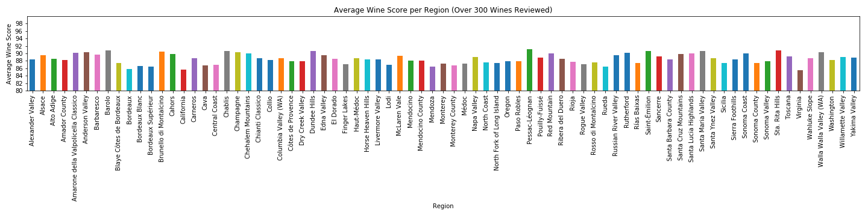
Average Wine Ratings per Region

Slide 11
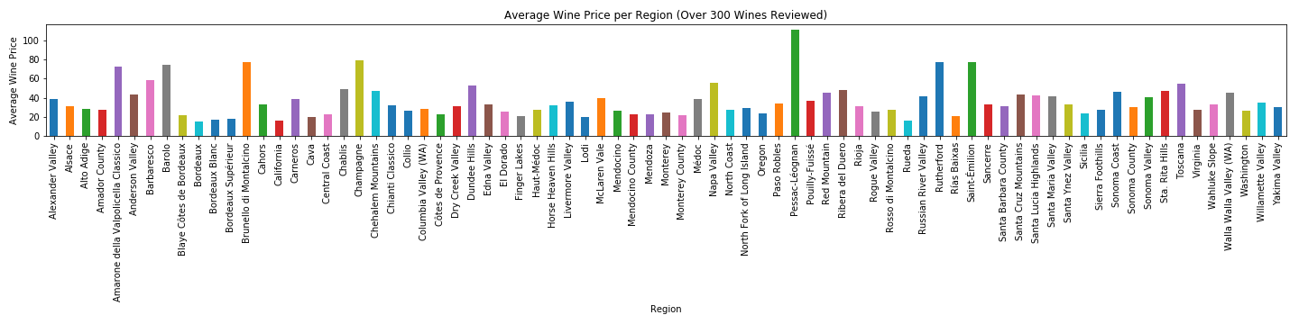
Average Price of Wine per Region
We can see that while still hovering around average, prices have many more spikes than rating. This is because prices are subject to many more factors than the rating.

Slide 12
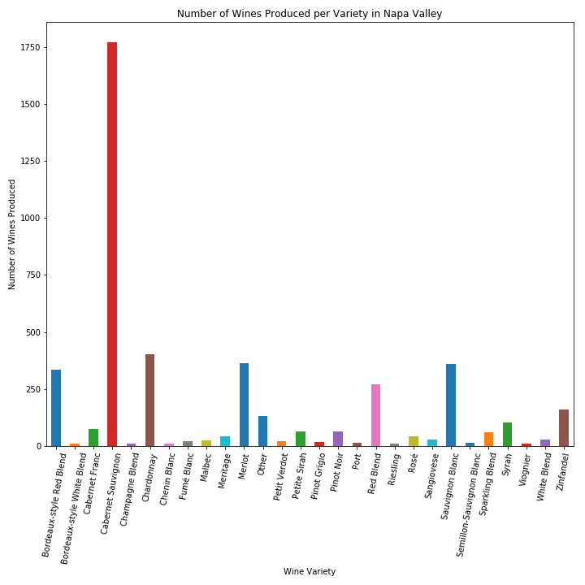
Wine Varieties Produced in Napa Valley
Clear focus on certain wine varieties in Napa Valley. This is expected because certain regions have favorable qualities for certain varieties. Producing a particular variety in those regions will yield a better wine than producing in a different region.

Slide 13
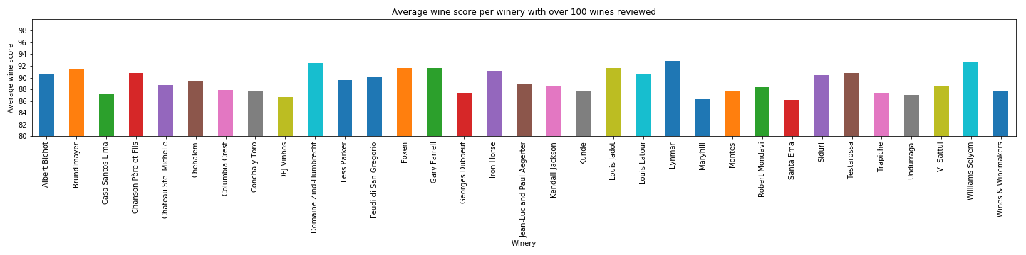
Wine Ratings by Winery

Slide 14
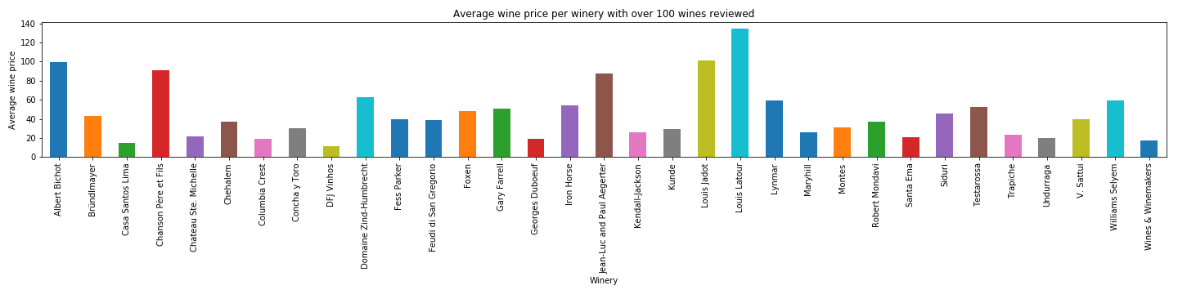
Wine Prices by Winery

Slide 15
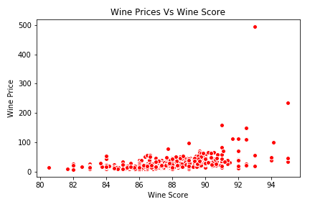
Wine Price vs Score
Clear trend: as the wine score increases, so does the price.
Could be explained by subjective appreciation.

Slide 16
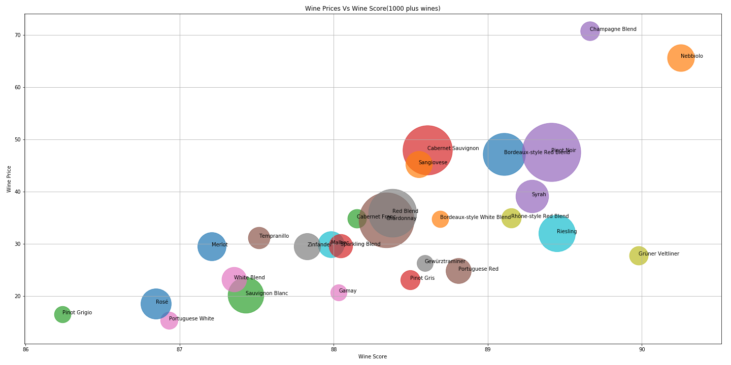
Correlation Between Price and Score of a Wine by Variety

Slide 17
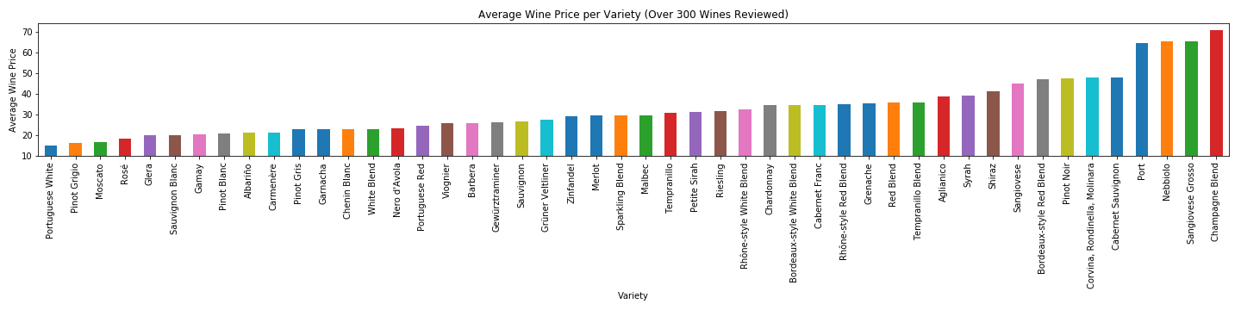
Average Price of Variety of Wine
Champagne blends have the highest average price.

Slide 18
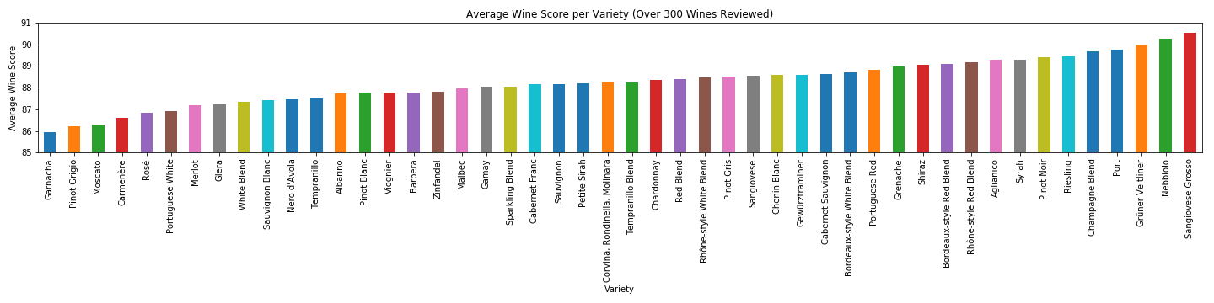
Average Score of Variety of Wine

Slide 19
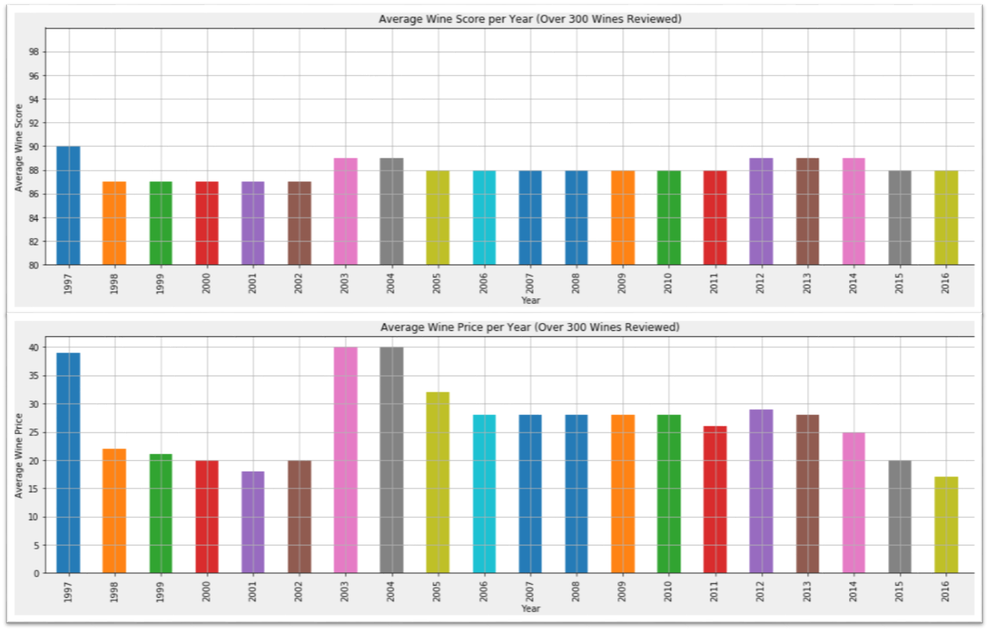
Mean Price and Rating per Vintage
As the rating increases or decreases slightly for a given year, the price increases or decreases at a much larger rate. This is because the value of the wines from “good” years are much higher than the wines from “bad” years.

Slide 20
Conclusions
The price of wine is highly correlated with the rating of the wine.
There is a clear difference in pricing between different varieties of wine.
Individual regions typically produce similar qualities of wine.
Certain countries and provinces are much more popular for producing wine.

Slide 21
Q&A
Thank you for listening.
Any questions?

